Slide 1
EPM/STARS INTRODUCTION
Wendy Monk
& Janet Poppel

Slide 2
Agenda
Query Manager Fundamentals:
1) Getting started using the query manager tool.
2) Data Dictionary
3) Describe and demonstrate how to find an existing query.
4) Create a query, add criteria, add prompt, and execute.

Slide 3
Introduction

Slide 4
Data dictionary
EPM

Slide 5
Using data dictionary
Reporting Table Name: Utilize this search field when you know the name of the Reporting Table and you would like to know more information specific to the table. *Remember all Reporting Tables begin with CTW_.
Reporting Table Field Name: Utilize this search field when you know the name of the Reporting Field and you would like to know which Reporting Tables utilize this field. *Remember, the name of a Reporting Field utilizes a CORE CT naming convention.
Reporting Field Label Name: Utilize this search field when you don’t know the name of the Reporting Field but rather know commonly used words that may be associated with one or more Reporting Fields

Slide 6
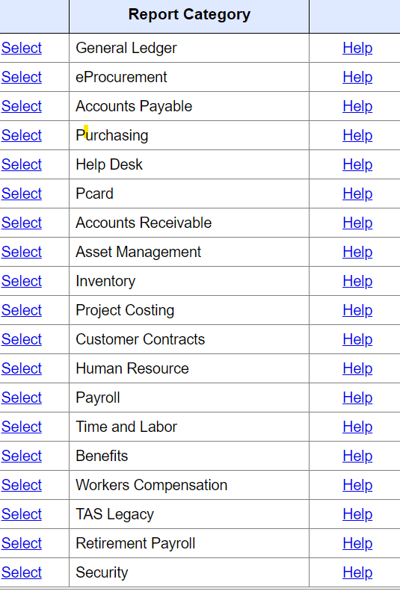
EPM REPORTING TABLES
Core-CT>Catalog of Reports>Choosing EPM Queries

Slide 7
DATA DICTIONARY
REPORTING TABLE NAME:
WHICH REPORTING TABLE YOU WANT TO USE. PLEASE REMEMBER ALL REPORTING TABLES START WITH CTW_
REPORTING TABLE FIELD NAME:
THE FIELD YOU ARE LOOKING TO HAVE THE REPORT FROM
SHORT DESCRIPTION
REPORTING FIELD LABLE NAME:
THE REPORTING field column title /header

Slide 8
Footprint tickets

Slide 9
Closing statements
We encourage users to create or utilize public queries when they can.
Footprint Tickets are for assistance in modifying queries, questions, and/or request training.
Class video recording available in teams.
Documentation available in teams meeting.

