Slide 1
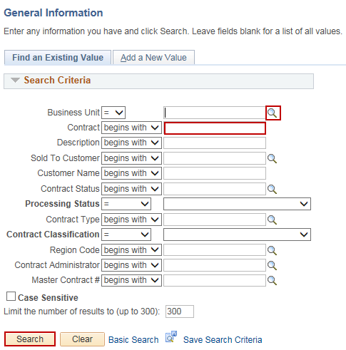
Unlinking a Project and Activity from an Existing Contract
Purpose:
This job aid will help you unlink a Project and Activity from an existing Contract in Core-CT.
Steps | Screenshots
Navigate to the Customer Contracts General Information page: Main Menu > Core-CT Financials > Customer Contracts > Create and Amend > General Information
Use the lookup icon to select a valid Business Unit. Enter the existing Contract. Click the Search button.
Click the Lines tab.
In the Contract Lines section, click the Detail tab. Click the Contract Terms link.

Slide 2
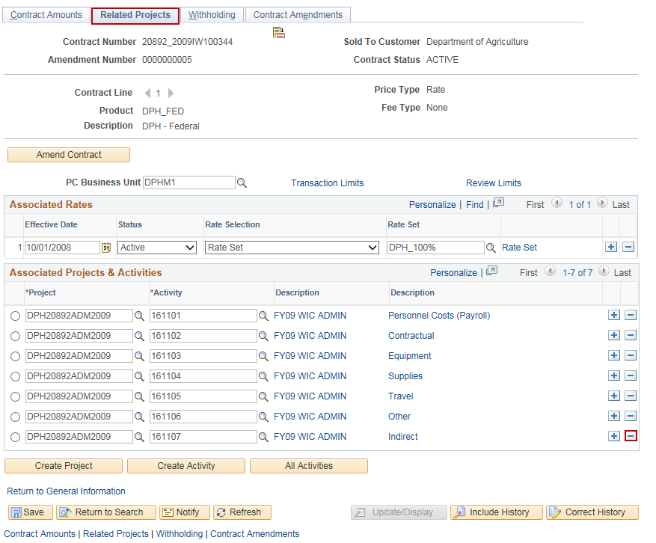
Unlinking a Project and Activity from an Existing Contract
Steps | Screenshots
Click the Related Projects tab. In the Associated Projects & Activities section, click the “-” button to remove each associated project and activity from the contract.
Click the OK button.

Slide 3
Unlinking a Project and Activity from an Existing Contract
Steps | Screenshots
Click the Save button.
Follow the steps outlined in the Create a Customer Contract with Rate-Based Contract Line Job Aid to link the existing Project and Activity(ies) to the new Grant Contract.

