Slide 1
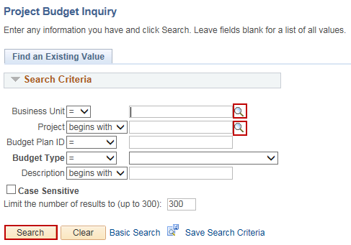
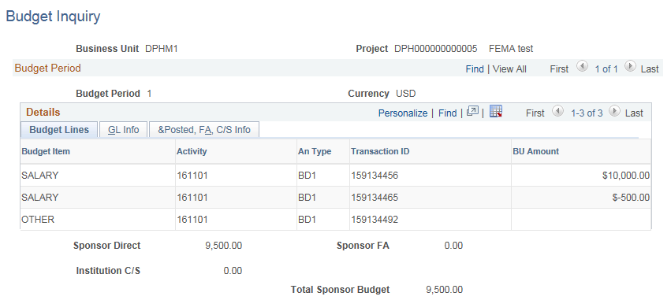
Review Budget
Purpose:
This job aid will help you review an awarded budget for a Grant in Core-CT.
Steps | Screenshots
Navigate to the Project Budget Inquiry page: Main Menu > Core-CT Financials > Grants > Awards > Project Budget Inquiry
Use the lookup icon to select a valid Business Unit. Use the lookup icon to select a valid Project or enter any other search criteria. Click the Search button.
The Budget Lines tab is displayed with the Budget Item, Activity, An Type (Analysis Type), Transaction ID and the BU Amount.

Slide 2
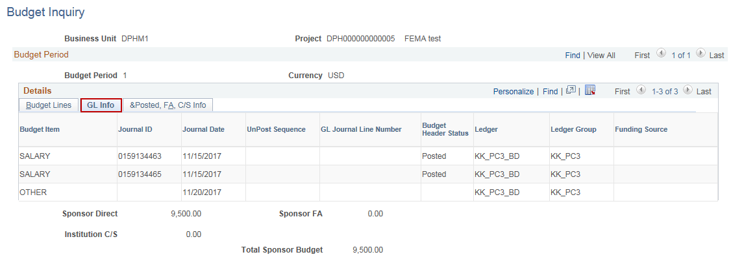
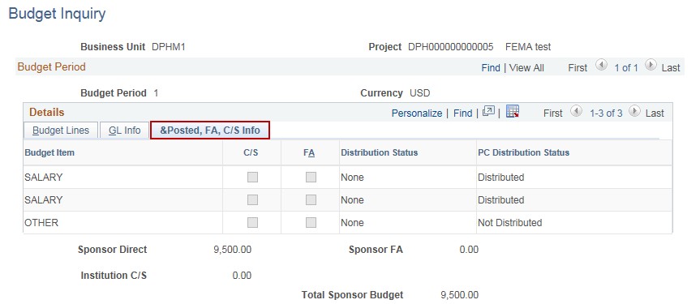
Review Budget
Steps | Screenshots
Click on the GL Info tab to view that the budget lines are created.
Click on the &Posted, FA, C/S Info tab to view the distribution status of the budget lines.

