Slide 1
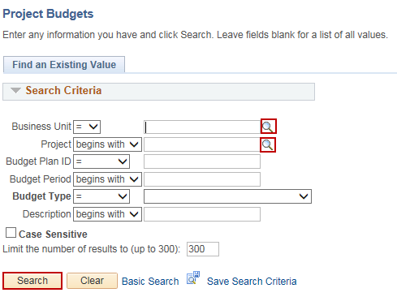
Finalize Project Budget
Purpose:
This job aid will help you finalize a project budget in Core-CT.
Steps | Screenshots
Navigate to the Project Budgets page: Main Menu > Core-CT Financials > Grants > Awards > Project Budgets
Use the lookup icon to select a valid Business Unit. Use the lookup icon to select a valid Project. Click the Search button.
Enter the Fund Code, Department, Special ID (SID), Program Code, Account and Budget Reference (Bud Ref) for each budget line. Click the Save button. Click on the Finalize button.

Slide 2
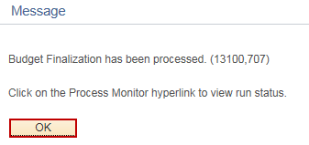
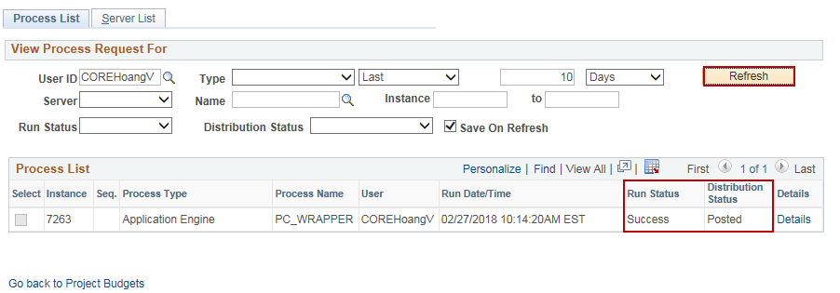
Finalize Project Budget
Steps | Screenshots
Click the OK button in the popup message.
Click on the Process Monitor hyperlink.
Optional: Click on the Refresh button until the Run Status displays Success and the Distribution Status displays Posted.

Slide 3
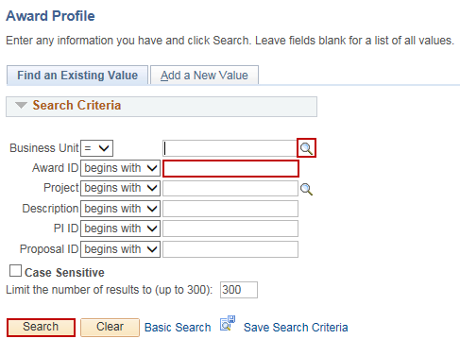
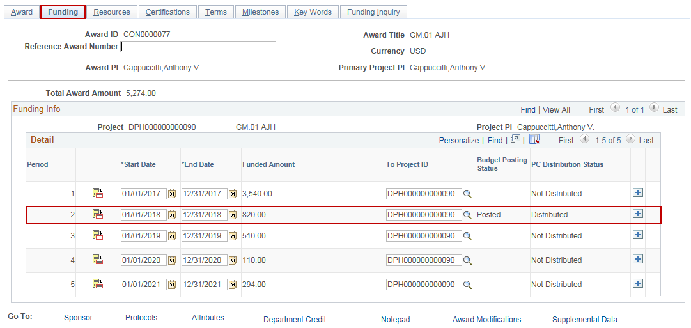
Finalize Project Budget
Steps | Screenshots
Navigate to the Award Profile page: Main Menu > Core-CT Financials > Grants > Awards > Award Profile
Use the lookup icon to select the Business Unit. Enter the Award ID. Click the Search button.
Click on the Funding tab. The Finalized budget period displays a Budget Posting Status as Posted and a PC Distribution Status as Distributed.

