Slide 1
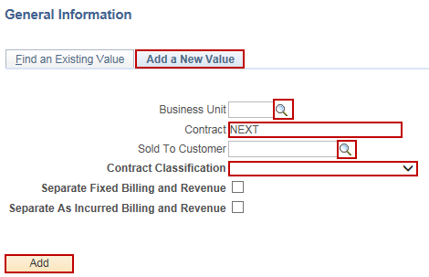
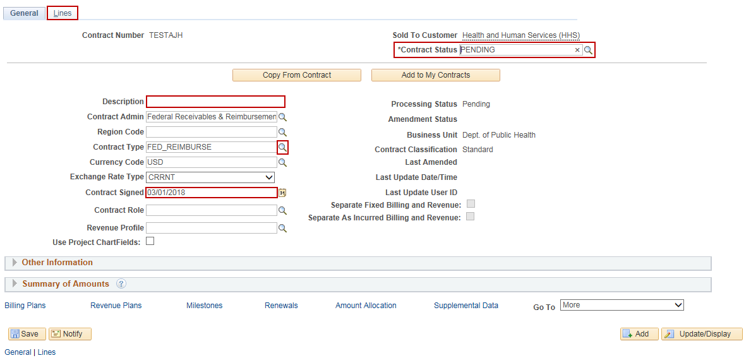
Create a Customer Contract with Rate-Based Contract Line
Purpose:
This job aid will help you create a Customer Contract with a rate-based contract line in Core-CT.
Steps | Screenshots
Navigate to the Contracts General Information page: Main Menu > Core-CT Financials > Customer Contracts > Create and Amend > General Information
Select the Add a New Value tab. Use the lookup icons to select a valid Business Unit and Sold To Customer. Enter a Contract name. Select the Contract Classification as Standard. Click the Add button.
Enter a description in the Description field. Click the Contract Type lookup to select GRANTS. Today’s date will default in the Contract Signed field. Update, as necessary. Validate that the Contract Status is Pending. Click the Lines tab.

Slide 2
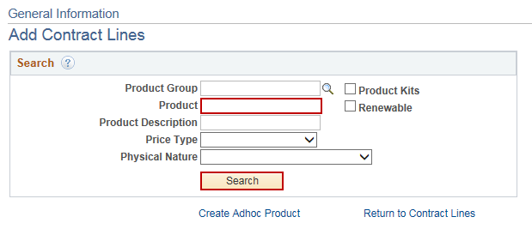
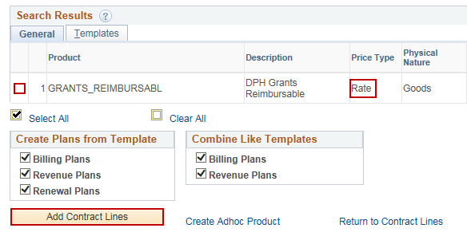
Create a Customer Contract with Rate-Based Contract Line
Steps | Screenshots
Click the Add Contract Lines button.
Enter in GRANTS_REIMBURSABL in the Product field. Click the Search button.
Select the checkbox to the left of the GRANTS_REIMBURSABL product, which needs to have a Price Type of Rate. Click the Add Contract Lines button.

Slide 3
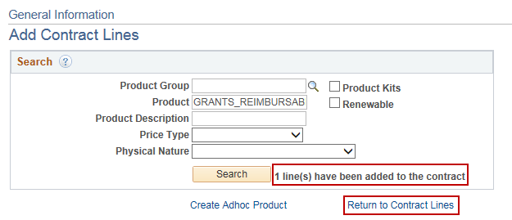
Create a Customer Contract with Rate-Based Contract Line
Steps | Screenshots
A message displays that 1 item has been added to the contract. Click the Return to Contract Lines link.
Enter a Start Date and End Date. Click the Save button. Click on the Detail tab.
Click on the Contract Terms link.

Slide 4
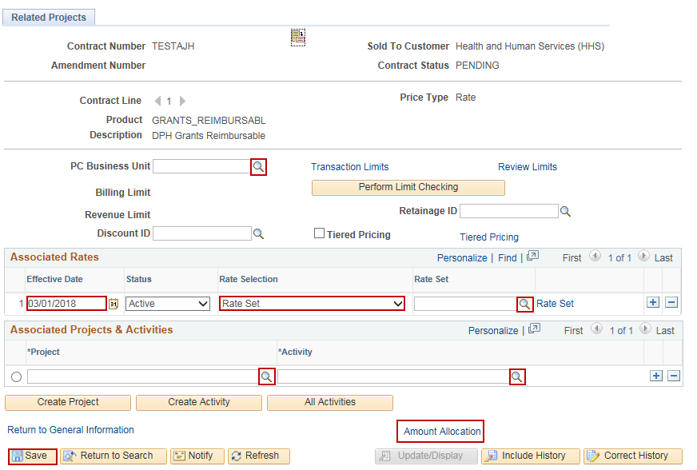
Create a Customer Contract with Rate-Based Contract Line
Steps | Screenshots
Use the lookup to select PC Business Unit. Enter the Effective Date. Use the dropdown menu to select a Rate Selection (for Grants, normally select Rate Set). Use the lookup icon to select Rate Set or Rate Plan. Use the lookup icons to select Project and Activity (see Step 29 if associating an existing project). Click the Save button. Note: If associating an existing project, navigate to the old project’s contract and delete the activity row by clicking the “-” button on the Associated Projects & Activities row. Then, go back to the new contract and select the activity with the associated project. View the Unlinking a Project and Activity from an Existing Contract Job Aid for more information. Click the Amount Allocation link.

Slide 5
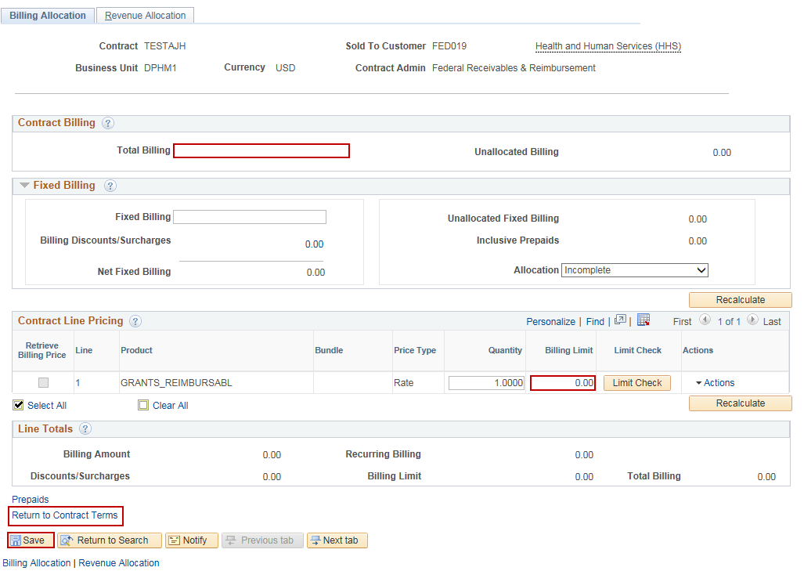
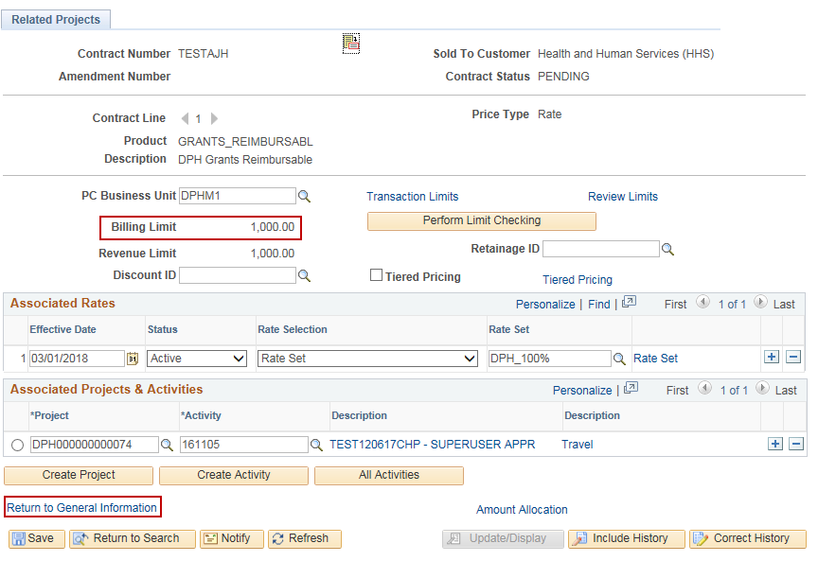
Create a Customer Contract with Rate-Based Contract Line
Steps | Screenshots
Enter the Billing Limit in the Total Billing field. In the Contract Line Pricing section, enter the Billing Limit. Click the Save button. Click the Return to Contract Terms link.
The Billing Limit displays. Click the Return to General Information link.

Slide 6
Create a Customer Contract with Rate-Based Contract Line
Steps | Screenshots
37. Click the Return to General Information link.
38. Select the General tab. 39. Click the Contract Status lookup button to select Active.
40. Click the Lines tab. 41. Validate that the Status is now Active.
42. Select the Detail tab to verify that the Billing Plan and Revenue Plan statuses are set to Ready.

Slide 7
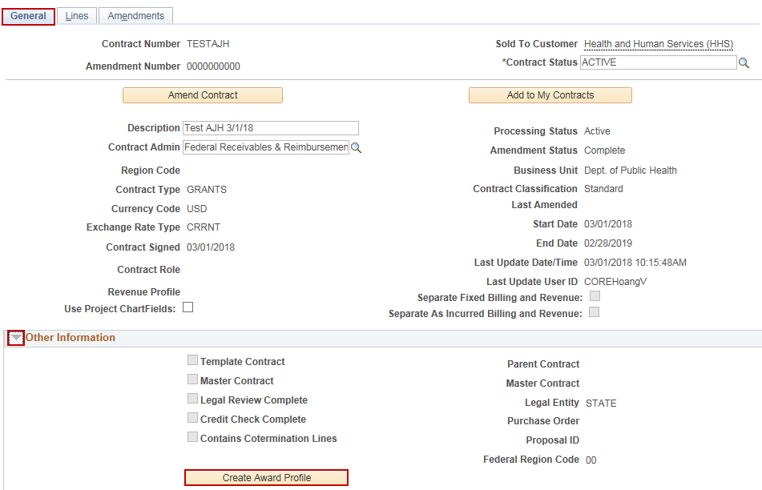
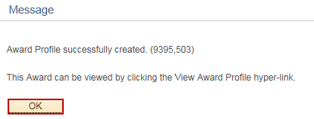
Create a Customer Contract with Rate-Based Contract Line
Steps | Screenshots
43. Click the General tab. 44. Click on the grey arrow icon to expand the Other Information section. 45. Click the Create Award Profile button.
46. Click the OK button.
47. Click the View Award Profile link.

Slide 8
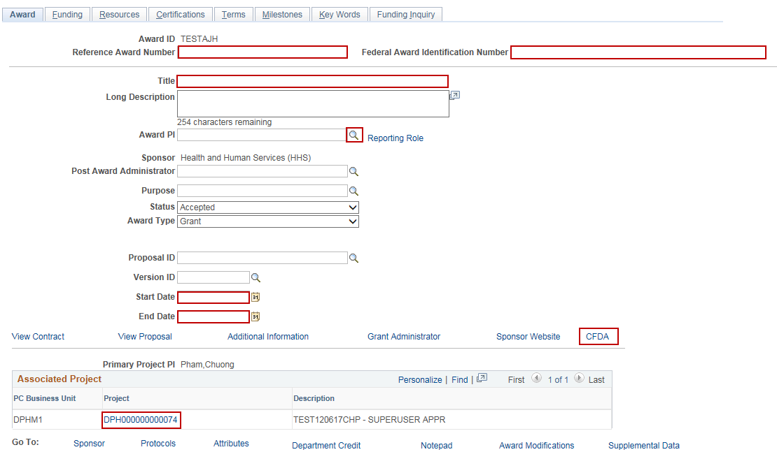
Create a Customer Contract with Rate-Based Contract Line
Steps | Screenshots
48. Optional: Enter the Reference Number and Federal Award Identification Number. 49. Enter a Title. 50. Select the Award PI. 51. Click on the CFDA link to select a CFDA number. 52. Enter the Start Date and End Date. 53. Verify that the Project ID displays at the bottom of the page.

Slide 9
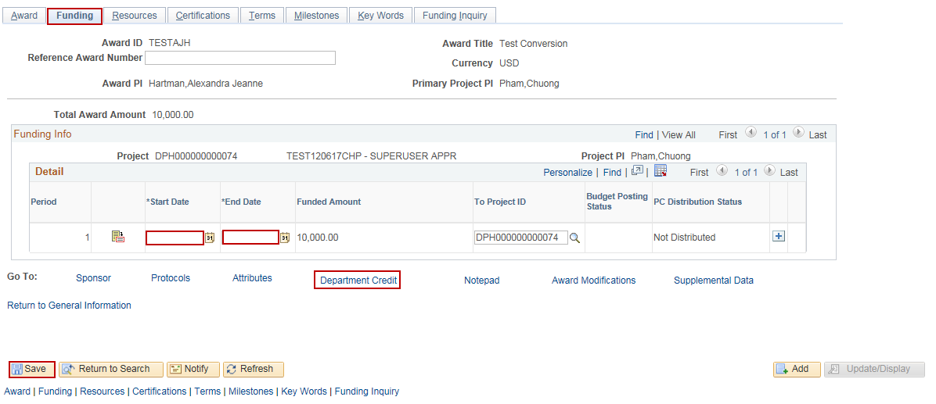
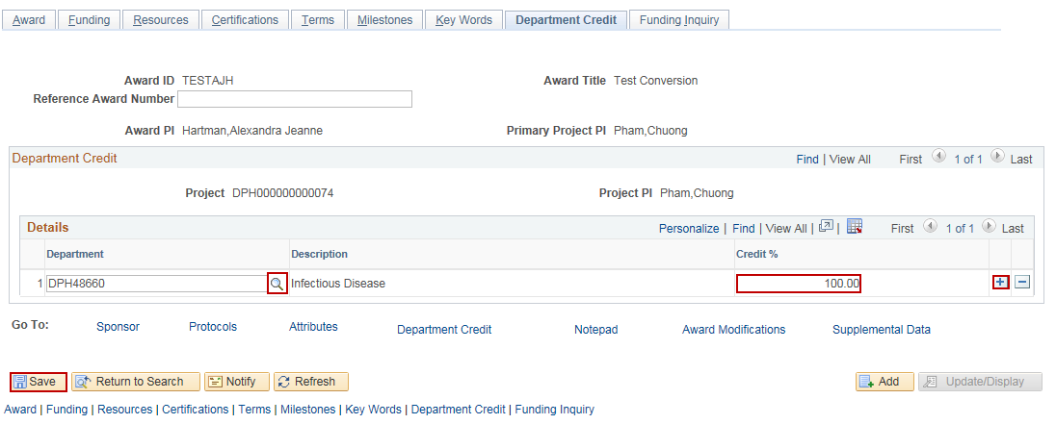
Create a Customer Contract with Rate-Based Contract Line
Steps | Screenshots
54. Select the Funding tab. 55. Enter the Project Start Date and End Date. 56. Click the Save button. 57. Click the Department Credit link.
58. In the Department field, select a Department using the lookup. 59. Optional: Click the “+” button to add additional Departments. 60. Enter the Credit % for the department. 61. Click the Save button.

Slide 10
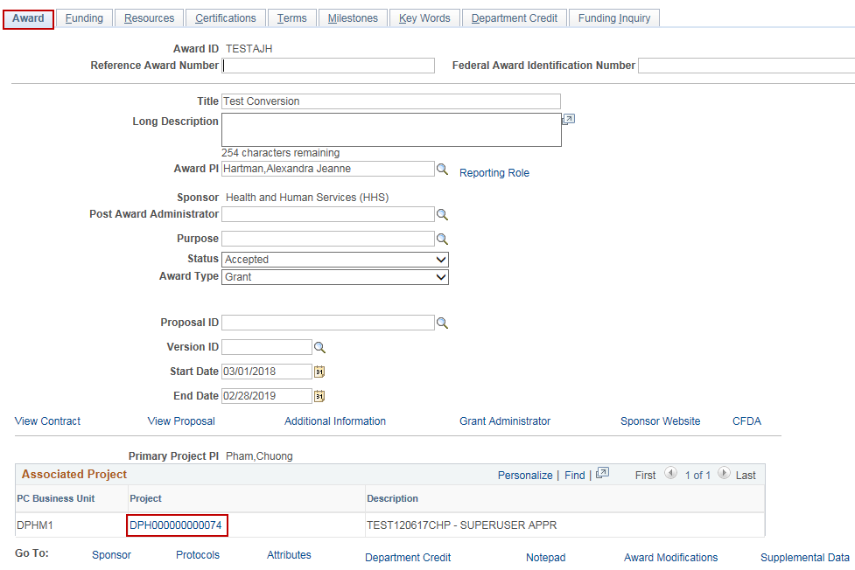
Create a Customer Contract with Rate-Based Contract Line
Steps | Screenshots
62. Click on the Award tab. 63. In the Associated Project section, click on the Project hyperlink.
64. Use the lookup icon to select the Project Type. 65. Update the Project Status

Slide 11
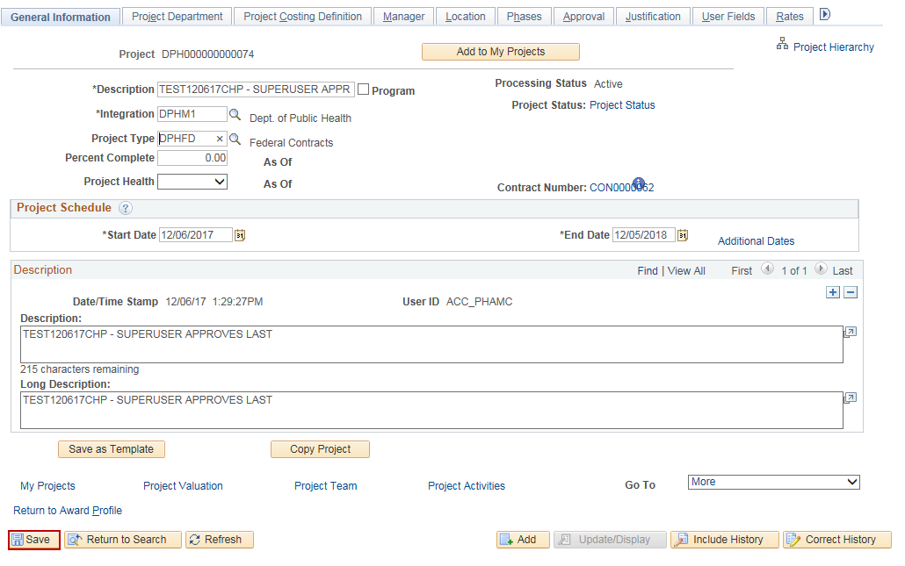
Create a Customer Contract with Rate-Based Contract Line
Steps | Screenshots
66. Click the OK button.
67. Click the Save button.

Slide 12
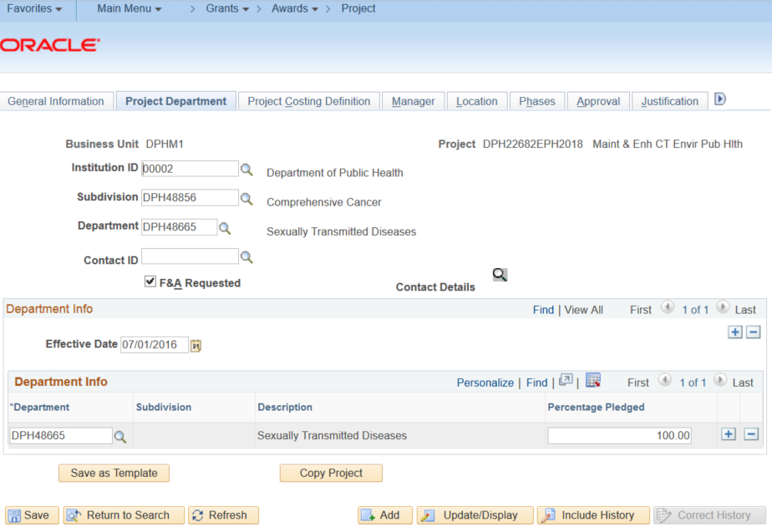
Create a Customer Contract with Rate-Based Contract Line
Steps | Screenshots
68. Select Project Department Tab. a. Input Institution ID, Subdivision, and Department. b. Under Department Info Box > Input Department ID > Input Pledge Percentage.
69. Click the Save button.

Slide 13
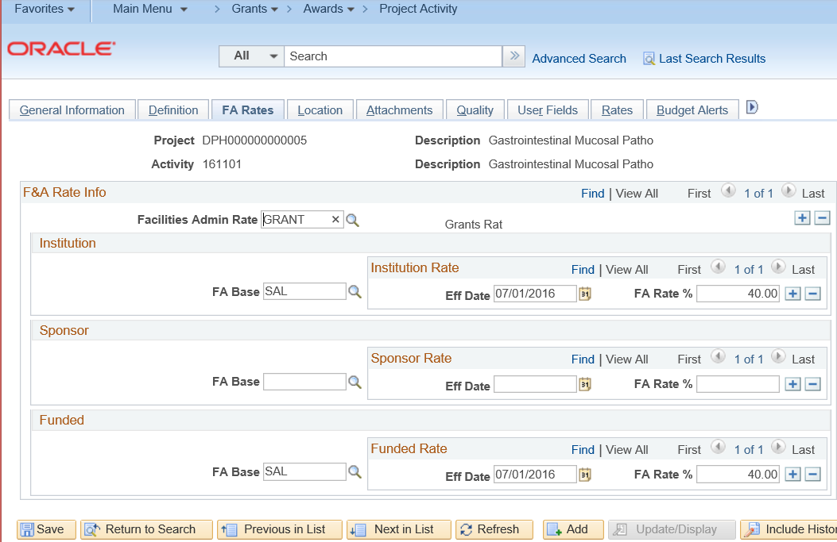
Create a Customer Contract with Rate-Based Contract Line
Steps | Screenshots
70. Update F&A % Rate of the Project & Activity for the Award. a. Navigate to Award Profile > Project Activity > Select ActivityID > FA Rates Tab. b. Click Facilities Admin Rate Lookup icon > Select “Grants” c. Click FA Base Lookup icon>Select “SAL” under Funded. d. Select Effect Date under Funded Rate. Ensure FA Rate % populates correctly.
71. Click the Save button.

