Slide 1
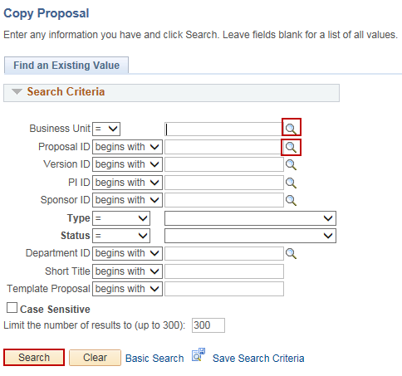
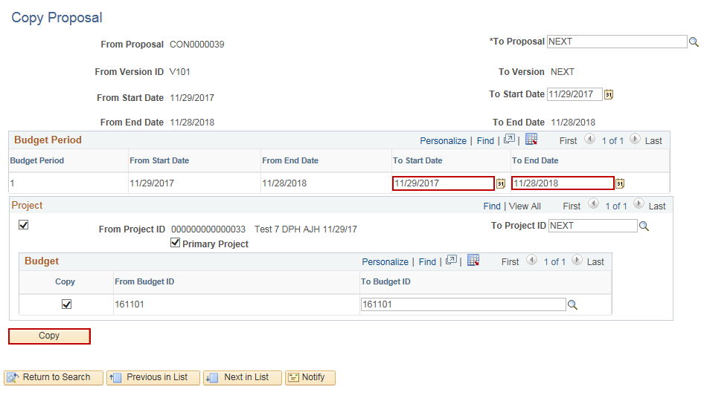
Copy a Grant Proposal
Purpose:
This job aid will help you create a Grant Proposal in Core-CT.
Steps | Screenshots
Navigate to the Copy Proposal page: Main Menu > Core-CT Financials > Grants > Proposals > Copy Proposal
Use the lookup icon to select a valid Business Unit. Use the lookup icon to select a valid Proposal ID or enter any other search criteria. Click the Search button.
Update the To Start Date and To End Date fields with the new proposal’s Start and End Dates. Click the Copy button.

Slide 2
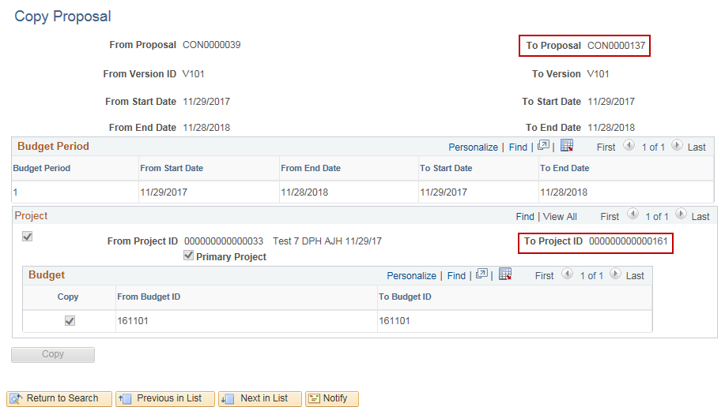
Copy a Grant Proposal
Steps | Screenshots
The To Proposal field will display the new, copied Proposal ID. The To Project ID field will display the new, copied Project ID. This value can be changed when Generating Award. Navigate to the Maintain Proposal page to view the new, copied proposal. All fields are editable in the new proposal.

