Slide 1
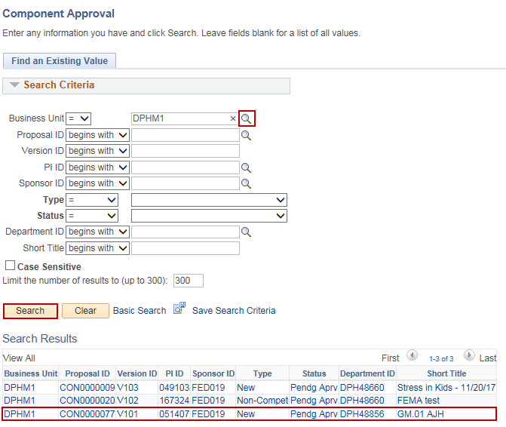
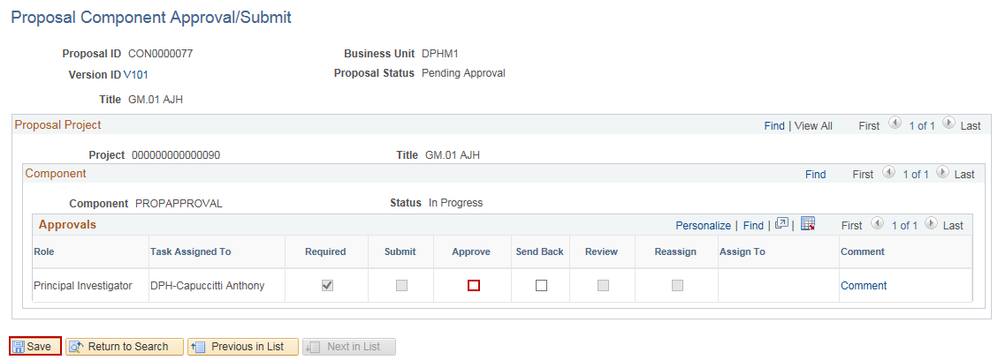
Approve a Grant Proposal
Purpose:
This job aid will help you approve a Grant Proposal in Core-CT.
Steps | Screenshots
Navigate to the Proposal Component Approval page: Main Menu > Core-CT Financials > Grants > Proposals > Proposal Component Approval
Use the lookup icon to select a valid Business Unit. Click the Search button. Select the Proposal link.
Click the Approve checkbox to approve the proposal. Click the Send Back checkbox to send the proposal back to the previous approver. Click the Save button.

Slide 2
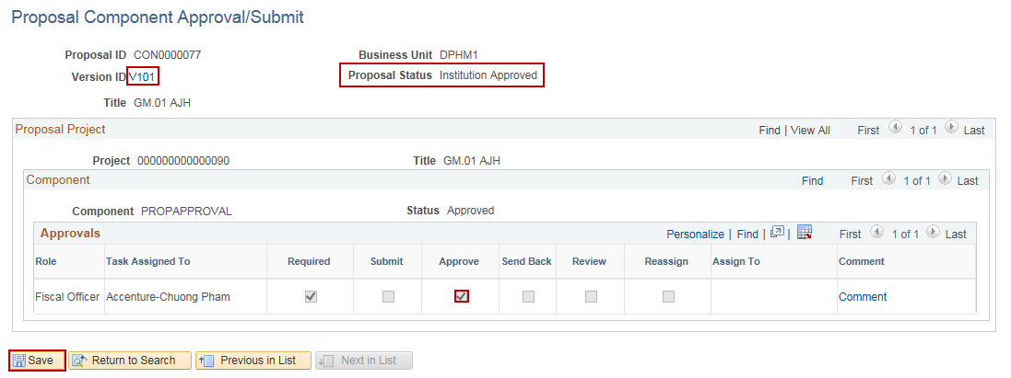
Approve a Grant Proposal
Steps | Screenshots
The proposal will then be sent to the next Approver in the Workflow. Repeat steps 5-7 for each Approver. Once the last Approver has Approved, the Proposal Status will change to Institution Approved. Click the Version ID hyperlink to view the Proposal.

Slide 3
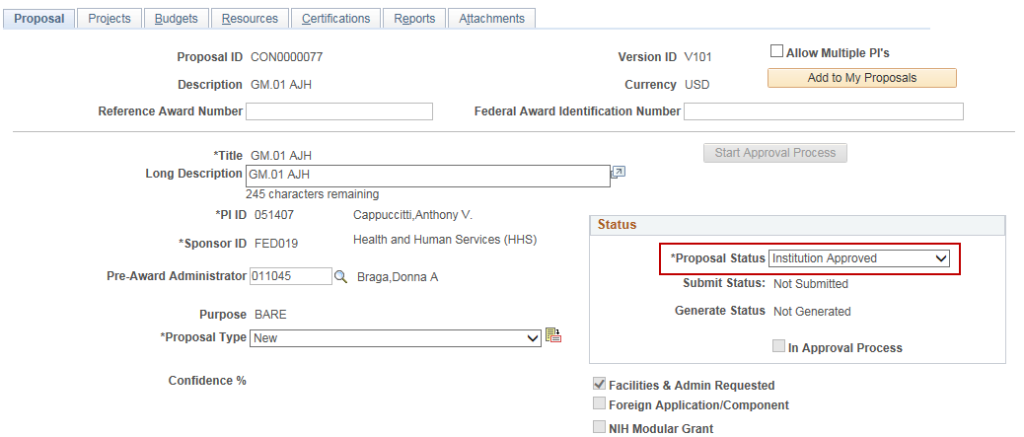
Approve a Grant Proposal
Steps | Screenshots
The Proposal Status has been updated to Institution Approved.
Note: Once the Proposal has been submitted to Workflow, each Approver will receive an email notification that they need to approve a proposal. The notification can also be viewed via the Grants WorkCenter: Main Menu > Core-CT Financials > Grants > Grants WorkCenter Or can be viewed in the Approver’s Worklist: Main Menu > Core-CT Financials > Worklist > Worklist

