Slide 1
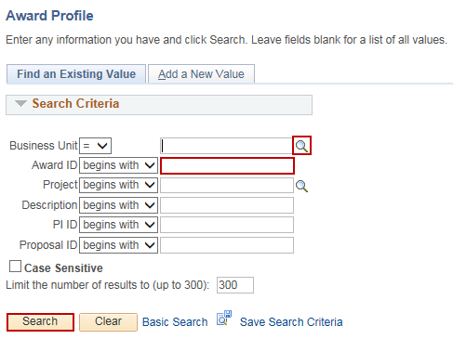
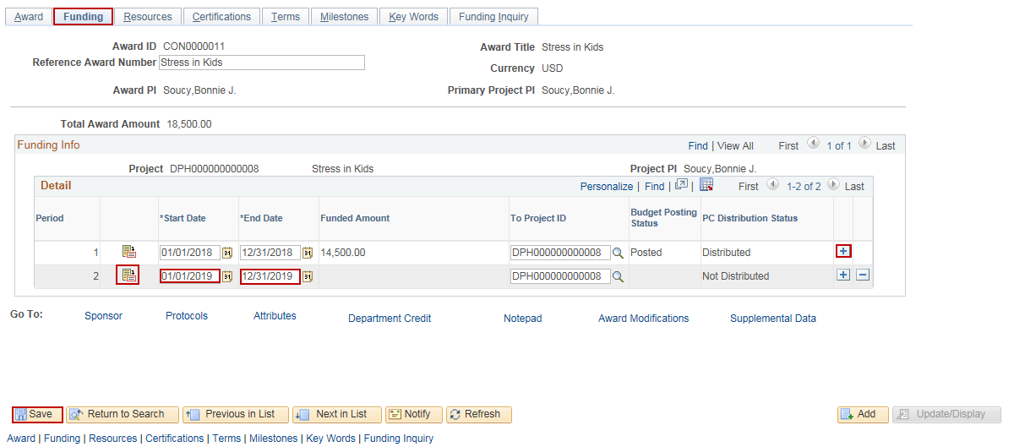
Add Budget Period
Purpose:
This job aid will help you add a Budget Period to an awarded grant in Core-CT.
Steps | Screenshots
Navigate to the Award Profile page: Main Menu > Core-CT Financials > Grants > Awards > Award Profile
Use the lookup icon to select a valid Business Unit. Enter a valid Award ID or enter any other search criteria. Click the Search button.
Click on the Funding tab. Click the “+” button to add another Budget Period. Enter the Start Date and End Date of the new Budget Period. Click the Save button. Click on the Budget Detail icon.

Slide 2
Add Budget Period
Steps | Screenshots
In the Budget Amount for Period section, enter the Fund Code, Department, Special ID (SID), Program Code, Account, Budget Reference, Activity, Analysis Type and Amount.
Click on the Commitment Control Detail tab. Update the Ledger Group to KK_PC3.
Use the scroll bar to view the remaining fields. Adjust the Budget Entry Type, Parent Budget Entry Type and Budget Line Code to Adjustment.

Slide 3
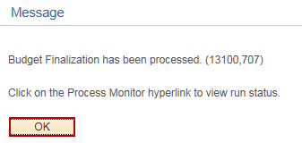
Add Budget Period
Steps | Screenshots
Click on the Grants Detail tab. Click on the lookup icon to update the Budget Item. Check the Facilities and Administration and/or Cost Sharing checkboxes, if necessary. Click the Save button.
Click the Finalize button.
Click the OK button.
Click the Process Monitor link to view the status of the Budget Update Process.

Slide 4
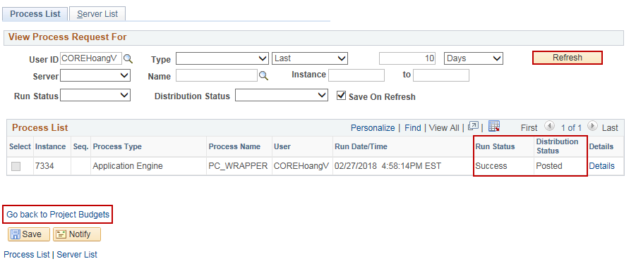
Add Budget Period
Steps | Screenshots
Optional: Click the Refresh button until the Run Status displays Success and the Distribution Status displays Posted. Click the Go Back to Project Budgets link.
Click on the Project Detail tab. Scroll to the Projects Distribution Status field to confirm that the budget displays Distributed to Commitment Control.

